Slide 1

Machine Learning: Unlocking the Future
Machine learning (ML) is a powerful technology that enables computers to learn from data and make predictions without explicit programming.

Slide 2
Introduction to Machine Learning
What is Machine Learning?
Types of Machine Learning
ML involves algorithms that analyze data, identify patterns, and make predictions or decisions. It's like teaching a computer to learn from experience.
There are three main types: supervised, unsupervised, and reinforcement learning.

Slide 3
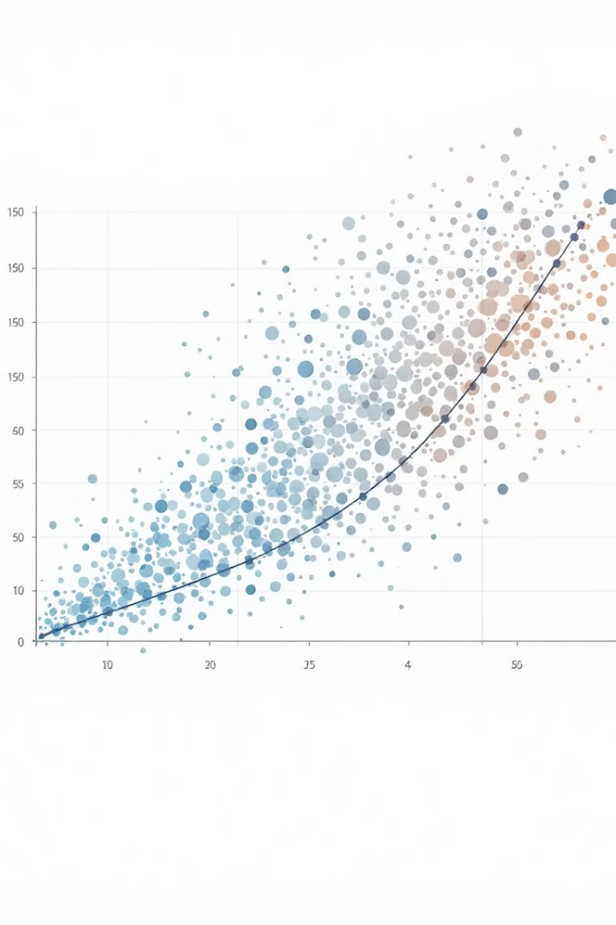
Supervised Learning: Predictive Modeling
1
Trains a model on labeled data, where each input is associated with a known output.
2
Uses this knowledge to predict the output for new, unseen data.
3
Examples include spam detection, fraud detection, and image classification.

Slide 4

Unsupervised Learning: Discovering Hidden Patterns
Unlabeled Data
Clustering
Dimensionality Reduction
Deals with unlabeled data, without predefined outputs. It's about finding patterns, anomalies, or structure.
Groups similar data points together, revealing underlying clusters in data.
Simplifies data by reducing the number of features without losing significant information.

Slide 5





Challenges and Ethical Considerations
Data Bias
Privacy and Security
Job Displacement
Explainability and Transparency

Slide 6

The Future of Machine Learning
As ML continues to evolve, we can expect even more transformative applications, with advancements in areas like healthcare, finance, and robotics.

